Slide 1


全球供应链促进报告及韧性指数矩阵
Global Supply Chain Promotion Report & Global Supply Chain Resilience Index Matrix
2026年6月

Slide 2

01
全球供应链促进报告2026
Global Supply Chain Promotion Report 2026

Slide 3

全球供应链促进报告2026：框架优化与内容升级
The Global Supply Chain Promotion Report 2026: Framework optimization and content upgrade
在延续全球篇、中国篇、产业篇三大结构的基础上，进一步优化框架、扩展内容，进行了系统优化升级。
Building on the continued framework of the three sections—the global sub-report, the China sub-report, and sub-reports on specific industries—the report has undergone systematic optimization and upgrading through further framework refinement and content expansion.
全球篇
Global Sub-report
01
中国篇
China Sub-report
02
产业篇
Sub-reports on
Specific Industries
03
系统梳理过去一年全球供应链促进体系的发展态势。
Offering a systematic review of the development trajectory of the global supply chain promotion system over the past year.
将能源基础设施纳入全球供应链促进分析体系。
Incorporating energy infrastructure into the global supply chain promotion analysis framework we initiated.
优化相关框架，全面总结中国因地制宜发展新质生产力、推进碳达峰碳中和战略与能源转型，为全球供应链开放合作带来的绿色转型机遇。
The relevant frameworks have been updated to comprehensively capture China's efforts in developing new quality productive forces tailored to local conditions, advancing its carbon peak and carbon neutrality strategy, and driving energy transition. These efforts collectively present green transformation opportunities for open cooperation within global supply chains.
新增人工智能、3D打印、氢能、钢铁、玉米、海运共6条全球供应链图谱。
Six new global supply chain diagrams have been formulated for artificial intelligence, 3D printing, hydrogen energy, steel, corn, and maritime transportation.

Slide 4
全球篇：基础设施硬件保障作用不断夯实
Global Sub-report: The foundational role of infrastructure in providing hardware safeguards
has been steadily strengthened
2023Q1-2025Q4全球班轮运输连通性指数
LSCI and PLSCI Globally, 2023Q1-2025Q4
资料来源/Source：联合国贸易和发展会议/ UNCTAD。
全球5G基站部署情况（单位：万个）
Statistics of 5G Base Stations Deployed Worldwide (unit: 10,000)
资料来源/Source：TD产业联盟/ TD Industry Alliance。
2025年12月全球范围内贸易金融货币份额
Share of Trade Finance via SWIFT by Currency, December 2025
资料来源/Source：环球银行金融电信协会/ SWIFT。
全球各类能源发电量
Global Electricity Generation by Source
资料来源/Source：恩伯/ Ember。

Slide 5
全球篇：多边贸易体制面临挑战，但全球供应链开放合作的大势未改
Global Sub-report: While the multilateral trading system faces challenges, the broader trend
toward openness and cooperation in global supply chains remains unchanged
2025年各经济体向WTO新报备的RTAs
New RTAs Notified by Economies to the WTO in 2025
歧视性/自由贸易措施
Discriminatory Trade Measures and Free Trade Measures
关税水平
Average Tariff Level
序号/No. | 协定名称/Name
1 | 亚美尼亚、白俄罗斯、哈萨克斯坦、吉尔吉斯斯坦、俄罗斯、塔吉克斯坦、乌兹别克斯坦服务贸易协定/Armenia, Belarus, Kazakhstan, Kyrgyzstan, Russia, Tajikistan, Uzbekistan Trade in Services Agreement
2 | 中国—马尔代夫自由贸易协定/China-Maldives FTA
3 | 澳大利亚—阿联酋自由贸易协定/Australia-UAE FTA
4 | 阿联酋—印度尼西亚自由贸易协定/UAE-Indonesia FTA
5 | 新西兰—阿联酋自由贸易协定/New Zealand-UAE FTA
6 | 非洲大陆自由贸易区/African Continental Free Trade Area (AfCFTA)
7 | 东南非共同市场—突尼斯加入/Common Market for Eastern and Southern Africa (COMESA)-Tunisia
8 | 欧盟—智利自由贸易协定/EU-Chile FTA
9 | 欧亚经济联盟—伊朗自由贸易协定/Eurasian Economic Union (EAEU)-Iran FTA
10 | 土耳其—阿联酋自由贸易协定/Türkiye-UAE FTA
3351 项
4.7%
2025年全球新增歧视性贸易措施
New Discriminatory Trade Measures Recorded Globally in 2025
2025年制造业领域平均关税水平
The Average Tariff Level in the Manufacturing Sector in 2025
1280 项
1.9%
2025年全球推出的自由贸易措施
Free Trade Measures Introduced Globally in 2025
2024年制造业领域平均关税水平
The Average Tariff Level in the Manufacturing Sector in 2024
遵循最惠国待遇原则的货物贸易比例
Share of Merchandise Trade Conducted under MFN Treatment
80%+
多边贸易体制在压力下仍展现出一定韧性，全球超八成货物贸易仍遵循最惠国待遇原则。
The multilateral trading system has demonstrated a certain degree of resilience under pressure. More than 80% of global merchandise trade continues to be carried out under the most-favored-nation principle.
2015-2025年累计向WTO通报和生效的RTAs
RTAs Notified to the WTO and Entered into Force, 2015-2025
资料来源/ Source：世界贸易组织/ WTO。

Slide 6
全球篇：部分经济体供应链政策具有较为明显的内顾倾向
Global Sub-report: Supply chain policies in certain economies have exhibited a pronounced
inward-looking tendency
1930年以来美国平均有效关税率
Changes in the U.S. Average Effective Tariff Rate Since 1930
资料来源/ Source：耶鲁大学预算实验室/ The Budget Lab at Yale。
截至2025年WTO成员通报的技术性贸易壁垒（TBT）数量
Number of TBTs Notified to the WTO by Its Members as of 2025
资料来源/ Source：世界贸易组织/ WTO。
2025-2026年美国平均关税税率
U.S. Average Tariff Rates by Year, 2025-2026
资料来源/ Source：世界贸易组织/ WTO。

Slide 7
全球篇：前沿技术是全球供应链发展的主要驱动力
Global Sub-report: Frontier technologies remain the primary drivers of global supply chain development
主流语言大模型
Mainstream Large Language Models
2024年底→2025年底 From End of 2024 to End of 2025
+30%
+50%
综合能力提升
Improvement in Comprehensive Capabilities
多模态理解能力提升
Improvement in Multimodal Understanding Capabilities
2015-2030年全球物联网设备数量
Number of IoT Devices Deployed Worldwide by Year, 2015-2030
资料来源/ Source：Ericsson Mobility Report。
全球商业CCUS项目数（左）及其碳捕集与封存能力（右）
Number of Commercial CCUS Projects Worldwide (Left) and Their Carbon Capture and Storage Capacity (Right)
资料来源/ Source：全球碳捕集与封存研究院/ Global CCS Institute。

Slide 8
全球篇：金融服务更具普惠性
Global Sub-report: Financial services demonstrate greater inclusivity
2018-2024年全球各地区供应链金融交易量
Transaction Volumes of Supply Chain Finance by Region, 2018-2024
资料来源/ Source：《世界供应链金融报告2025》/ World Supply Chain Finance Report 2025。
2014-2025年全球绿色贷款金额
Global Scale of Green Loans by Year, 2014-2025
资料来源/ Source：日本环境省/ Ministry of the Environment of Japan。
部分经济体中小微企业融资情况
Status of MSME Finance in Some Economies
资料来源/ Source：《中小微企业融资缺口报告》/ MSME Finance Gap。
2005-2025年全球碳市场覆盖的温室气体排放规模
Scale of Greenhouse Gas Emissions Covered by Global Carbon Markets by Year, 2005-2025
资料来源/ Source：国际碳行动伙伴组织/ International Carbon Action Partnership (ICAP)。

Slide 9
中国篇：更大范围、更深层次参与全球供应链分工和合作
China Sub-report: China has engaged in the division of labor and collaboration across
global supply chains on a broader scale and at a deeper level
完善基础设施网络
Improve the Infrastructure Network
扩大高标准自贸区网络
Expand the Network of FTAs
31个
24个
44%
截至2025年中国签署自贸协定国家
Countries with Which China Has Signed FTAs
截至2025年中国已签署自贸协定
FTAs signed by China as of 2025
与自贸伙伴贸易额占外贸总额
Proportion of Trade Volume with FTA Partners
中国
实践
2018-2025年中国铁路营业里程
Length of Operating Railways in China by Year, 2018-2025
数据来源/ Source：国家铁路局/ National Railway Administration of China。
建设科创高地
Build Sci-tech Innovation Hubs
人民币跨境支付系统（CIPS）更加便捷
CIPS Has Become More Convenient
60%
85.4%
68.5%
844.19万笔
180.15万亿元
人工智能专利
持有量占比
Share of AI Patent Holdings
重点工业企业数字化研发设计工具普及率
Penetration Rate of Digital R&D and Design Tools in Key Industrial Enterprises
处理业务总数
Total Number of
Transactions Processed
金额总计
Total Amount
(in Value)
关键工序数控化率
Numerical Control (NC) Rate of Key Production Processes

Slide 10
中国篇：以自身高质量发展为全球供应链合作持续创造机遇
China Sub-report: Through its own high-quality development, China continues to create
opportunities for global supply chain cooperation
全方位高水平的产业机遇
All-Round, High-Standard Industrial Cooperation Opportunities
加速释放的科技创新机遇
Accelerating Innovation and Development Opportunities in Science and Technology
中国
机遇
2016-2025年中国制造业增加值和占当年国内生产总值的情况
Share of the Added Value of China's Manufacturing Sector in Its GDP by Year, 2016-2025
数据来源/ Source：中国统计年鉴/ China Statistical Yearbook。
2016-2024年中国研发投入经费和强度
China's R&D Expenditure and Investment Intensity by Year, 2016-2024
资料来源/ Source：中国国家统计局/ National Bureau of Statistics of China。
潜力巨大的绿色转型机遇
Green Transformation Opportunities with Tremendous Potential
超大规模的市场机遇
Opportunities from a Supersized Market
2016-2024年中国绿色低碳专利申请公开情况
Statistics of Publicly Disclosed Green and Low-carbon Patent Applications in China by Year, 2016-2024
数据来源/ Source：绿色低碳专利统计分析报告（2025）/ Statistical Analysis Report on Green and Low-carbon Patents (2025)。
2016-2025年中国社会消费品零售总额
China's Retail Sales of Consumer Goods by Year, 2016-2025
资料来源/ Source：中国国家统计局/ National Bureau of Statistics of China。

Slide 11
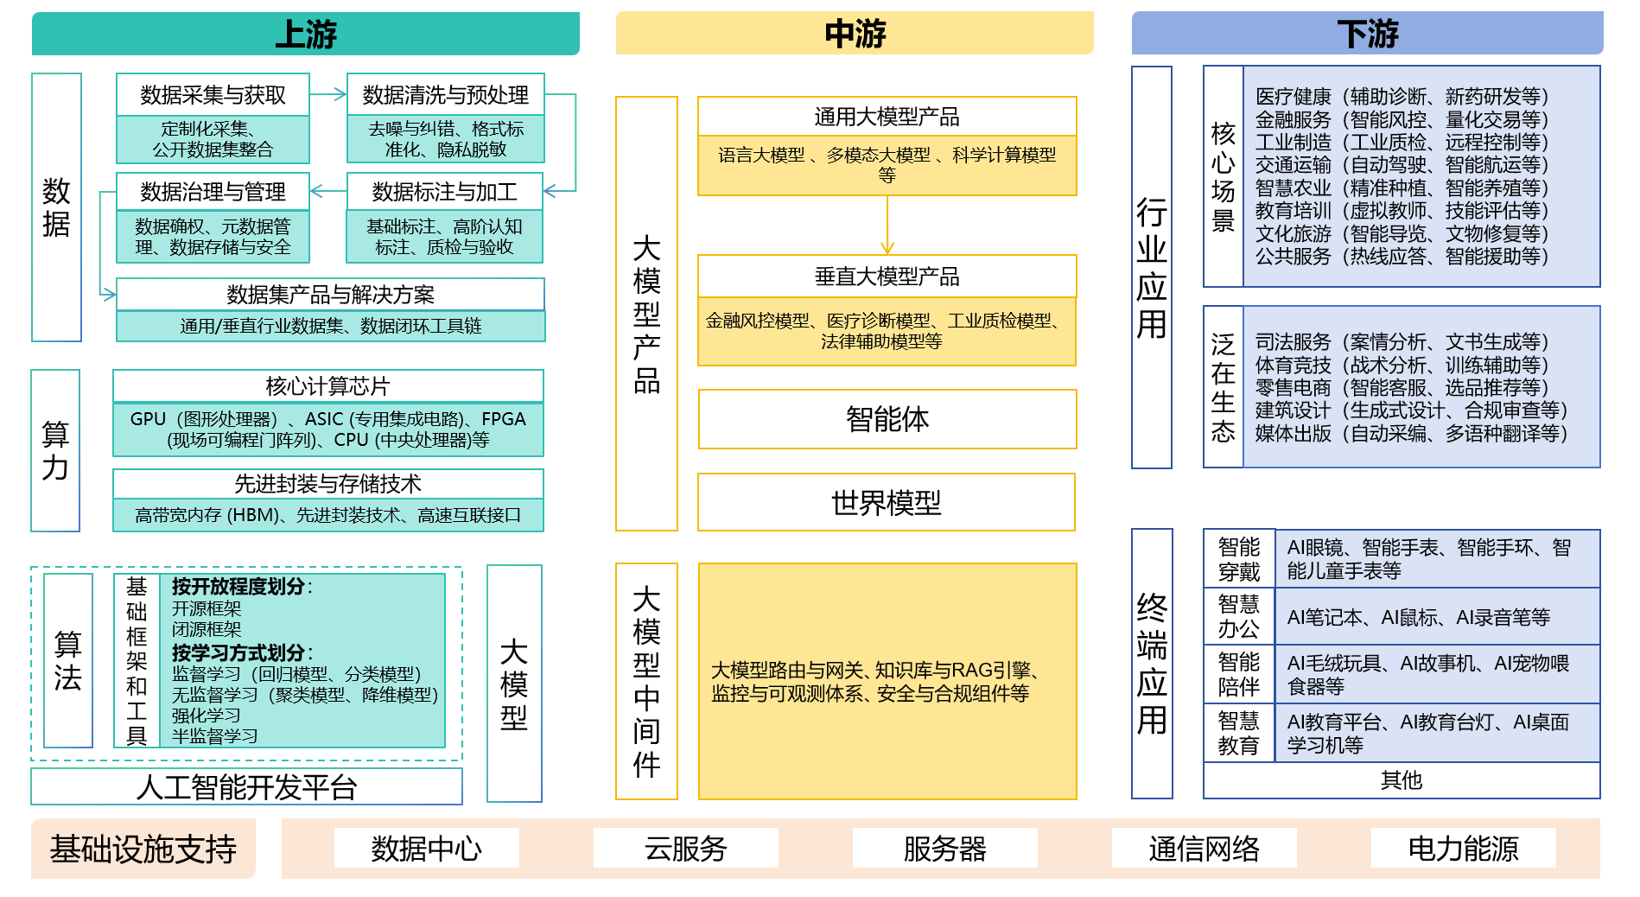
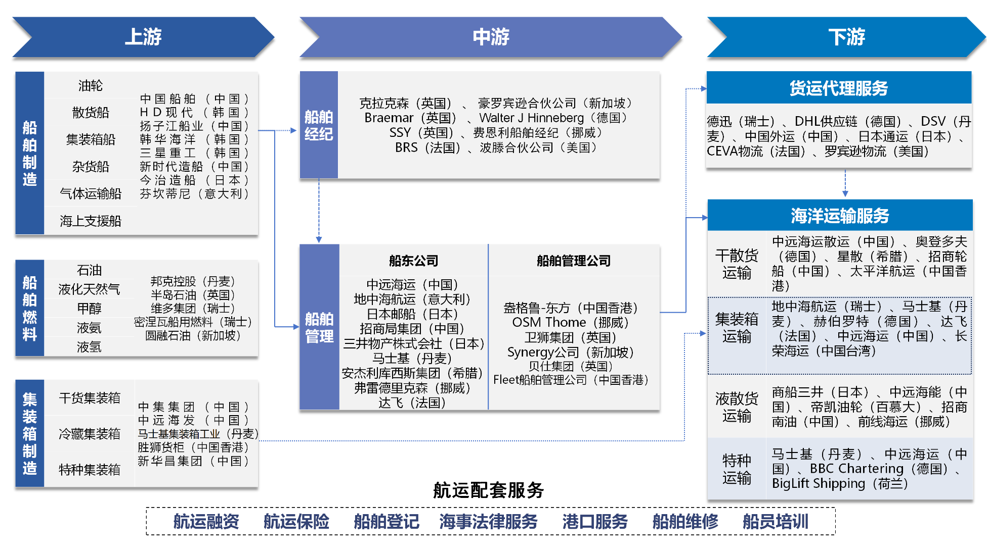
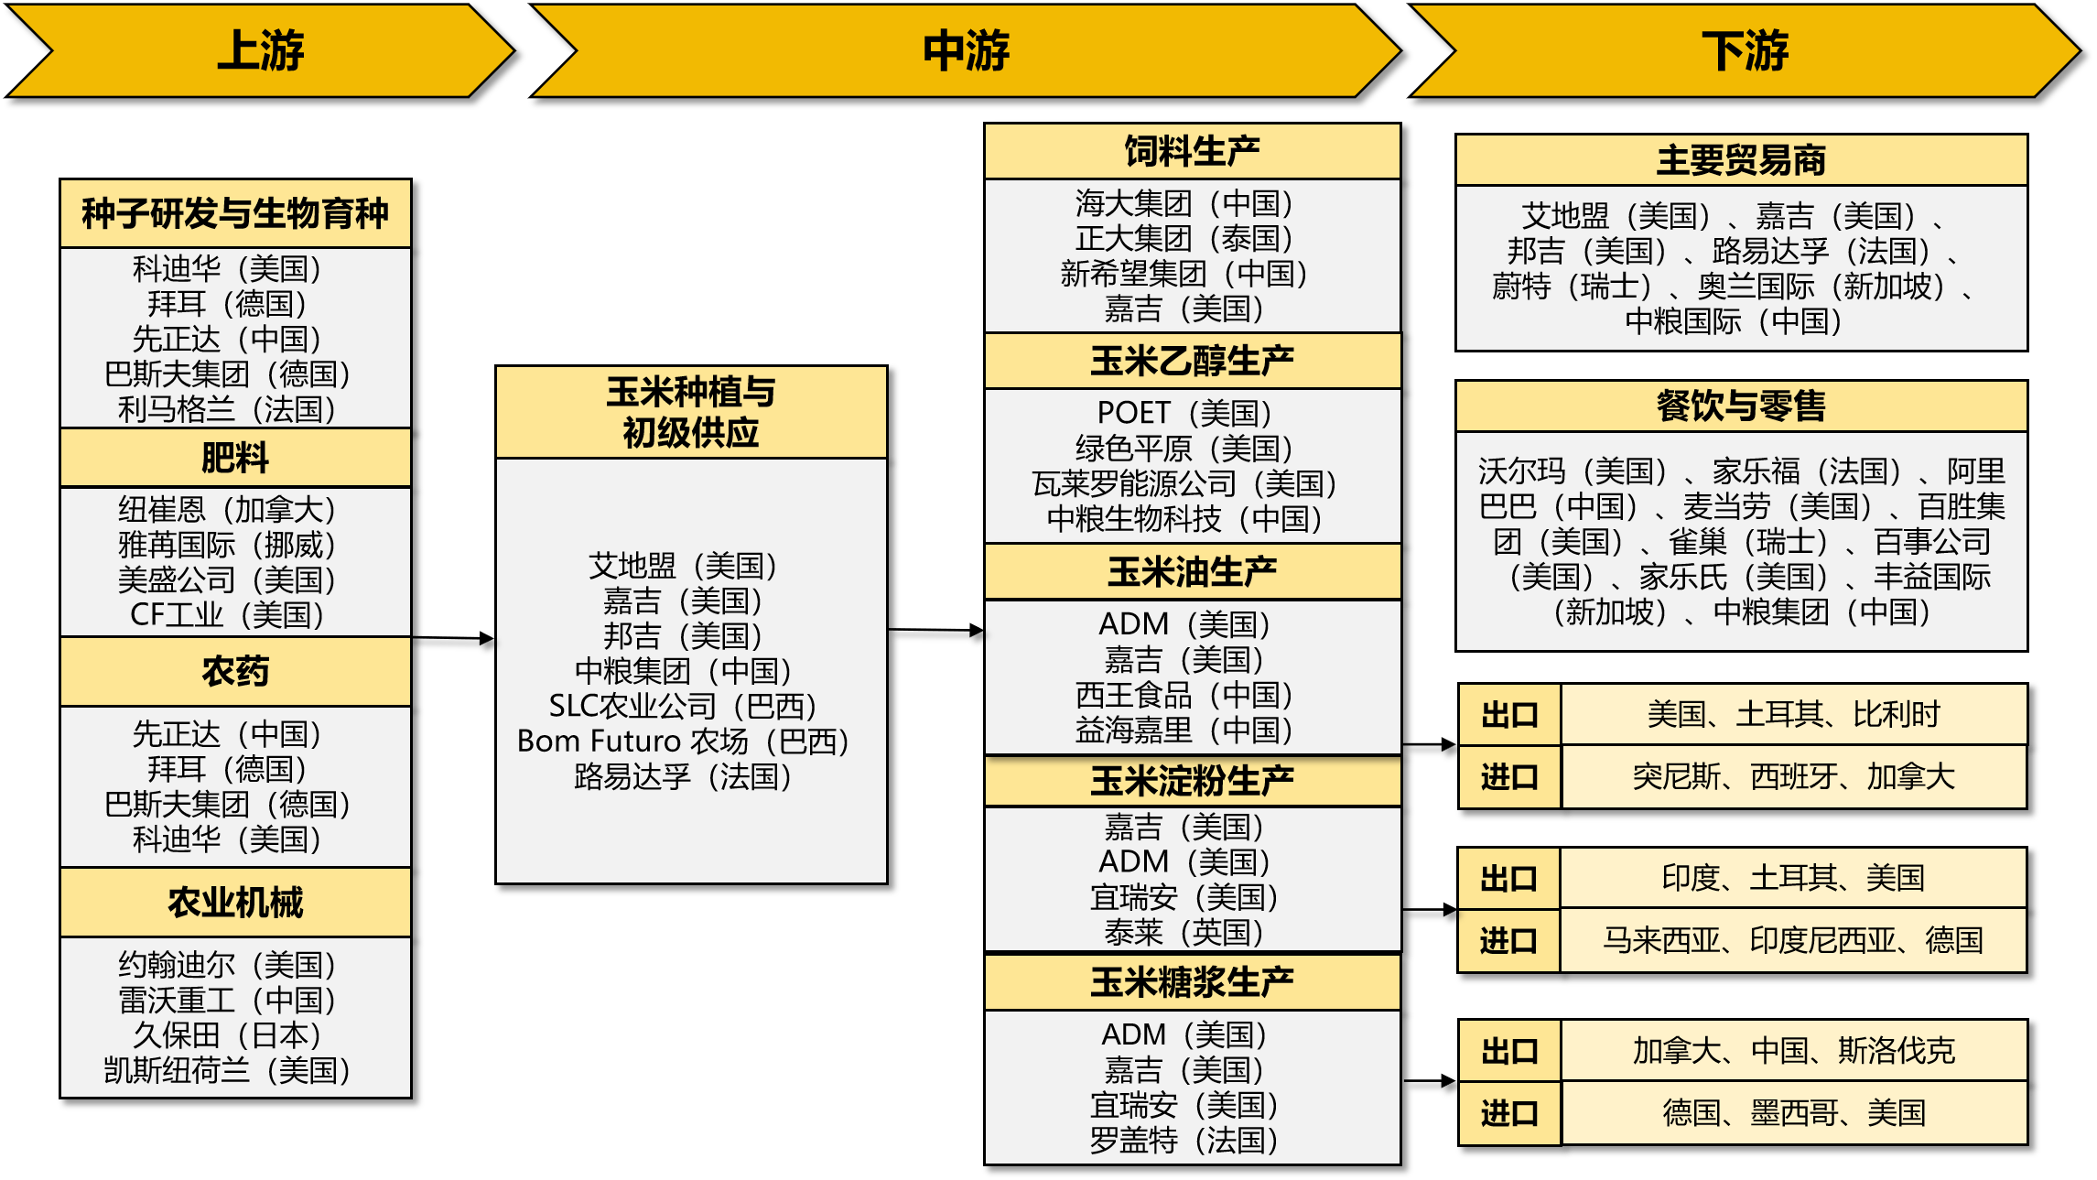
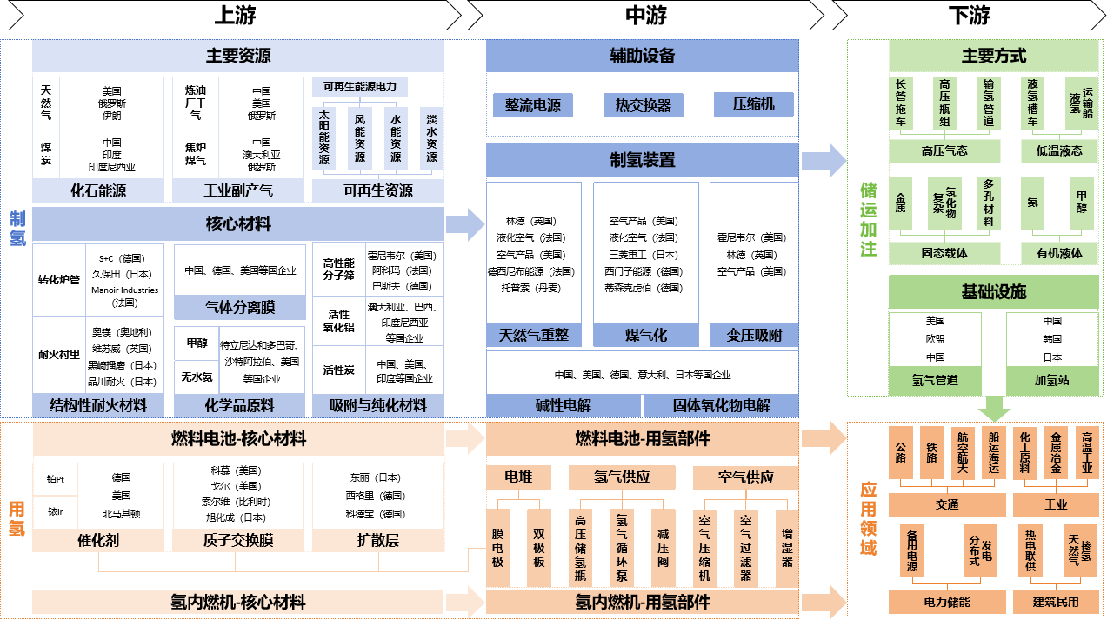
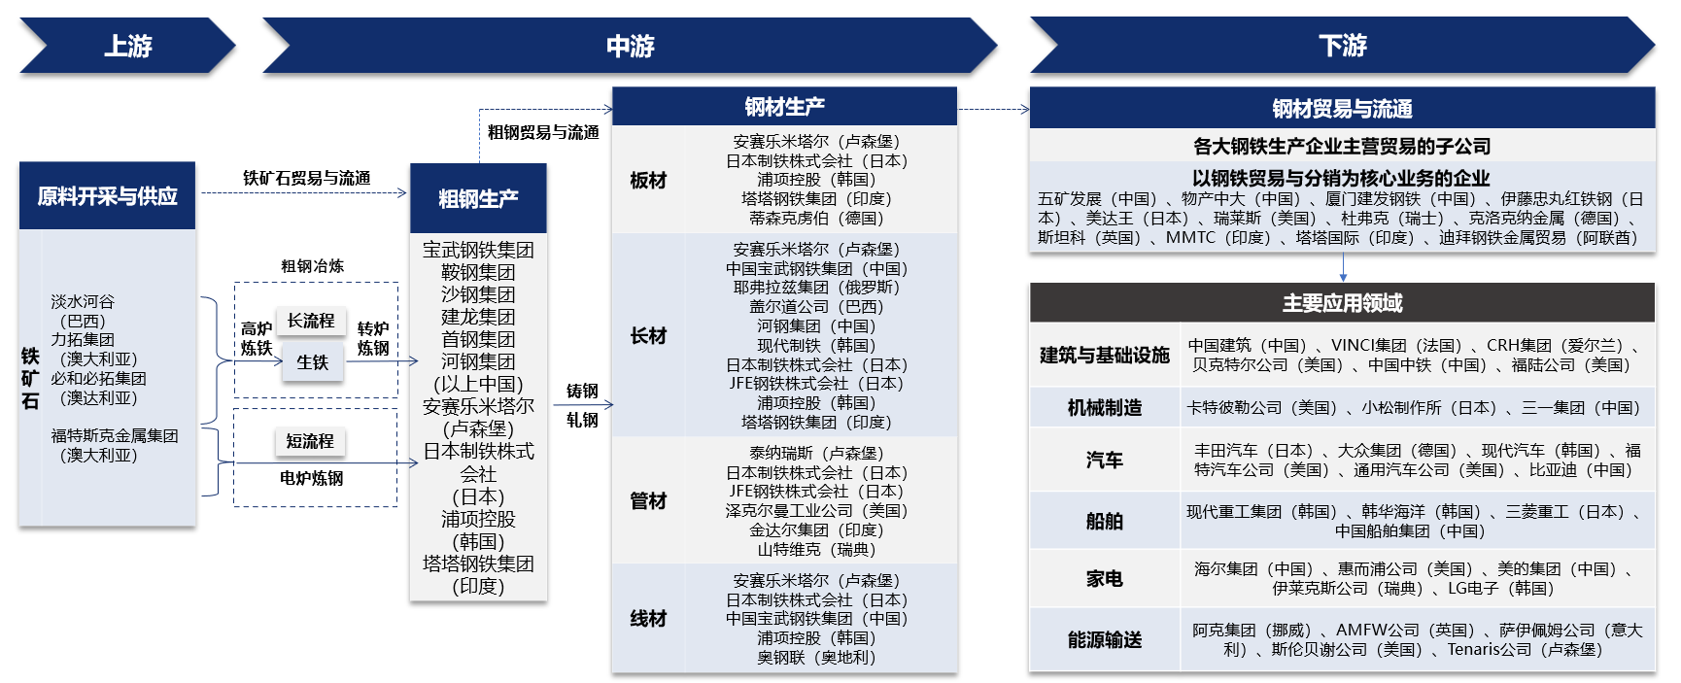
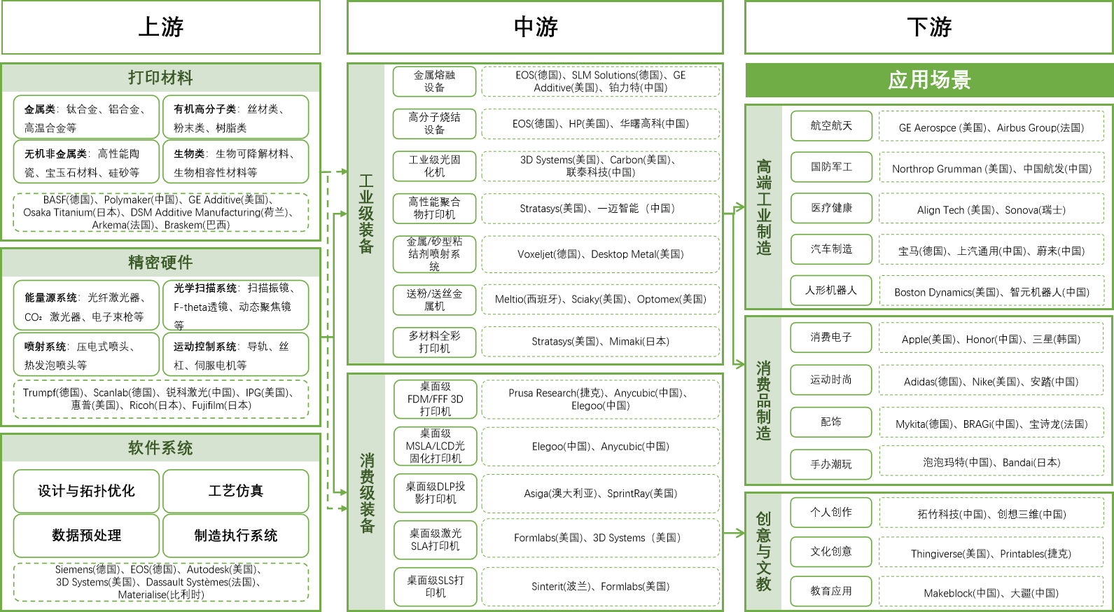
产业篇：新增6条全球供应链图谱
Sub-reports on specific industries: Six new global supply chain diagrams have been formulated
人工智能图谱 AI
海运图谱 Maritime Transport
玉米图谱 Corn
氢能图谱 Hydrogen
钢铁图谱 Steel
3D打印图谱 3D Printing

Slide 12
02
全球供应链韧性指数矩阵
Global Supply Chain Resilience Index Matrix

Slide 13
全球供应链韧性指数矩阵持续扩围
The global supply chain resilience index matrix has been steadily expanded
2026年，在滚动开发全球供应链促进指数、全球供应链连接指数、全球供应链创新指数、全球供应链韧性指数四个指数的基础上，新增美国供应链韧性指数、欧盟供应链韧性指数。
In 2026, building on the continuous development of the Global Supply Chain Promotion Index (GSCPI), the Global Supply Chain Connectivity Index (GSCCI), the Global Supply Chain Innovation Index (GSCII), and the Global Supply Chain Resilience Index (GSCRI), we have added the U.S. Supply Chain Resilience Index (USSCRI) and the EU Supply Chain Resilience Index (EUSCRI).
全球首发
First Released Globally
矩阵扩围
Expansion of the Index Matrix
经济体层面
Economy Level
首发促进指数、连接指数
First release of GSCPI/ GSCCI
新增美国供应链韧性指数、欧盟供应链韧性指数
Addition of USSCRI/ EUSCRI
欧盟供应链韧性指数
EUSCRI
美国供应链韧性指数
USSCRI
韧性指数 GSCRI
2024
2025
2026
促进指数 GSCPI
连接指数 GSCCI
矩阵成型
Formation of the Index Matrix
全球层面
Global Level
创新指数 GSCII
新增创新指数、韧性指数
Addition of GSCII/ GSCRI
全球供应链韧性指数矩阵逻辑架构
The Structure of the Global Supply Chain Resilience Index Matrix
资料来源/Source：中国贸促会研究院/ CCPIT Academy。

Slide 14





全球供应链韧性指数矩阵研究方法优化升级
Optimization and upgrade of research methodologies for the Global Supply Chain Resilience Index Matrix
沿用规范的统计学与计量经济学研究范式，优化数据处理方法，增加指数检验方法。
The Global Supply Chain Resilience Index Matrix adheres to rigorous statistical and econometric research paradigms, with further refinements made to data processing methodologies and the addition of index validation techniques.
各指数间逻辑关系的计量检验发现，韧性指数在各指数中居枢纽地位，故更名为“全球供应链韧性指数矩阵”。
Through econometric testing of the logical relationships among the indices, we found that the Resilience Index occupies a pivotal position within the index system. For this reason, the Global Supply Chain Index Matrix has been renamed the Global Supply Chain Resilience Index Matrix.
指数检验
Additional Index Validation
系统调节特征检验
Systemic Regulation
Effect Testing
因果关系检验
缺失数据填补
Missing Data Imputation
官方预测数据交叉验证
Cross-Validation Using Official Forecast Data
Causality Testing
关联趋势检验
Correlation and Trend Analysis
确保统计合理、趋势连贯、符合经济学规律。
Ensure that the indices are statistically rational, maintain coherence in annual trends, and align with the key laws of economics.

Slide 15




中长期：供应链全球化仍是大势所趋
Medium and long-term: Supply chain globalization remains a general trend
2018-2025年，促进指数、连接指数、创新指数、韧性指数均呈上行态势，表明全球供应链继续朝着更具韧性、更有效率、更富活力的方向发展。
From 2018 to 2025, the Promotion Index, Connectivity Index, Innovation Index, and Resilience Index all exhibited an upward trajectory, indicating that global supply chains continue to evolve toward greater resilience, efficiency, and dynamism.
促进指数 GSCPI
连接指数 GSCCI
创新指数 GSCII
韧性指数 GSCRI
2.839
1.657
2.565
1.249
年均复合增长率 CAGR 16.07%
促进指数 GSCPI
1
2.839
连接指数 GSCCI
1
1.657
7.48%
创新指数 GSCII
1
2.565
14.40%
韧性指数 GSCRI
1
1.249
3.23%
*基期/ Base Year 2018=1

Slide 16

中长期：韧性指数是各指数的枢纽
Medium and long-term: The Resilience Index serves as the linchpin of the Index Matrix
韧性指数与促进指数、连接指数、创新指数之间存在统计学意义上的因果关系。在韧性指数上升的年份，其余三个指数均上升。
The Resilience Index demonstrates significant causal relationships with the Promotion Index, Connectivity Index, and Innovation Index from a statistical perspective. In years when the Resilience Index rises, the other three indices also record increases.
促进指数
GSCPI
连接指数
GSCCI
创新指数
GSCII
边际显著影响
Marginally Significant Influence
显著影响
Significant Influence
显著影响
Significant Influence
韧性指数
GSCRI
全球供应链韧性指数矩阵逻辑架构
The Structure of the Global Supply Chain Resilience Index Matrix
资料来源/Source：中国贸促会研究院/ CCPIT Academy。
2018-2025年各指数走势折线图
Line Chart of the Trends of Four Indices from 2018 to 2025
资料来源/Source：中国贸促会研究院/ CCPIT Academy。

Slide 17
中长期：美欧供应链韧性指数呈现“美高欧低、美烈欧稳”的走势
Medium and long-term: The two indices display contrasting patterns, characterized by higher levels but greater volatility in the U.S. and lower levels but greater stability in the EU
2018-2025年，美国供应链韧性指数整体高于欧盟，但高位震荡明显。欧盟整体更低，但走势总体平稳。
From 2018 to 2025, the U.S. Supply Chain Resilience Index was generally higher than that of the EU, but experienced pronounced high-level volatility. The EU index was lower overall, but its trajectory remained generally stable.
美国供应链韧性指数
USSCRI
美国供应链韧性指数 USSCRI
历史高位 Historical Peak
1→1.349
欧盟供应链韧性指数 EUSCRI
历史高位 Historical Peak
年均复合增长率 CAGR
4.37%
欧盟供应链韧性指数
EUSCRI
1→1.094
年均复合增长率 CAGR
2018-2025年美国韧性指数和欧盟韧性指数走势折线图
Line chart of the trends of USSCRI and EUSCRI from 2018 to 2025
资料来源/Source：中国贸促会研究院/ CCPIT Academy。
1.29%

Slide 18




2025年：各指数增幅差异较大
The year 2025: The indices registered notably varied growth rates
促进指数、连接指数、创新指数再创新高，韧性指数仍未恢复至历史高位。
The Promotion Index, Connectivity Index, and Innovation Index reached new highs, while the Resilience Index has yet to recover to its historical peak.
韧性指数 GSCRI
历史高位
Historical Peak
促进指数 GSCPI 连接指数 GSCCI创新指数 GSCII
再创新高 Reached New Highs
促进指数 GSCPI
连接指数 GSCCI
4.93%
6.29%
全球供应链促进环境总体较好
The overall environment for supply chain promotion remains favorable.
全球供应链连接状态稳中向好
The state of global supply chain connectivity is stable and improving.
创新指数 GSCII
韧性指数 GSCRI
18.81%
2.19%
全球供应链创新水平大幅提升
The level of global supply chain innovation has been enhanced substantially.
全球供应链内在韧性缓慢恢复
The inherent resilience of global supply chains is in a phase of gradual recovery.
2018-2025年各指数走势折线图
Line Chart of the Trends of Four Indices from 2018 to 2025
资料来源/Source：中国贸促会研究院/ CCPIT Academy。

Slide 19



2025年：预防能力和恢复能力是影响全球供应链韧性的关键
The year 2025: Prevention capacity and recovery capacity are critical determinants of global supply
chain resilience
增强全球供应链韧性重在提升抵御冲击的能力，并守住恢复重建的能力底线
Enhancing global supply chain resilience hinges on strengthening risk resistance capacity and safeguarding
the baseline capacity for recovery and reconstruction.
恢复能力
韧性指数
GSCRI
抵御能力
Recovery Capacity
负向变动大幅拖累
显著正向拉动
Risk Resistance Capacity
Substantial Negative Impact
Significantly Positive Driving Effect
Recovery Capacity
Risk Resistance Capacity
Prevention Capacity
2025年韧性指数对一级指标正（右）/ 负（左）向冲击10%的响应
Response of the Resilience Index to ±10% shocks on first-level indicators in 2025
资料来源/Source：中国贸促会研究院/ CCPIT Academy。

Slide 20
2025年：美欧供应链韧性指数呈现“美缓欧快”的特征
The year 2025: The U.S. and EU Supply Chain Resilience Indices exhibit a pattern of moderate growth in the U.S. and accelerated growth in the EU
2025年，美国、欧盟供应链韧性指数均保持上升，但欧盟回升更快。
In 2025, both the U.S. and EU Supply Chain Resilience Indices maintained an upward trajectory, but the EU experienced a faster recovery.
美国供应链韧性指数 USSCRI
+1.89%
维持增长态势，但增速低于欧盟
Maintaining an upward trajectory, but its growth rate was lower than that of the EU.
欧盟供应链韧性指数 EUSCRI
+5.76%
2018-2025年美国韧性指数和欧盟韧性指数走势折线图
Line Chart of the Trends of USSCRI and EUSCRI from 2018 to 2025
资料来源/Source：中国贸促会研究院/ CCPIT Academy。
自2022年以来首次上涨
Its first upturn since 2022.

Slide 21
03
建议清单与不建议清单
“To-Do List” and “Not-to-Do List”

Slide 22
建议清单
To-Do List
1. 各方应坚持供应链全球化方向，维护以WTO为核心的多边贸易体制。
Uphold the direction of supply chain globalization, and safeguard the multilateral trading system with the WTO at its core.
2. 坚持开放合作的政策导向，强化供应链国际分工合作。
Maintain a policy orientation toward open cooperation, and strengthen the international division of labor and collaboration within supply chains.
3. 推进海运、铁路、航空、管道等运输方式高效衔接，促进供应链基础设施联通。
Promote the efficient interconnection of maritime, rail, air, and pipeline transportation to enhance supply chain infrastructure connectivity.
4. 深化供应链创新合作，便利创新要素跨境流动，减少技术获取壁垒、降低使用门槛、弥合“技术鸿沟”。
Deepen cooperation in supply chain innovation, facilitate the cross-border flow of innovation factors, reduce barriers to technology access, lower thresholds for technology application, and bridge the technological divide.
5. 加强供应链风险信息共享，提升自然灾害、公共卫生事件、武装冲突等重大冲击的协同应对能力。
Strengthen the sharing of supply chain risk information, and enhance the capacity for coordinated response to major shocks, including natural disasters, public health emergencies, and armed conflicts.

Slide 23
不建议清单
Not-to-Do List
1. 各方应共同抵制单边主义、保护主义行为，反对以单边加征关税、设置歧视性条件或实施制裁等方式解决供应链领域分歧。
Oppose unilateralism and protectionism, and resist the practice of resolving supply chain disputes through unilateral tariff hikes and imposition of discriminatory measures or sanctions.
2. 杜绝将经贸问题泛政治化、泛安全化，反对借国家安全之名在非敏感领域出台限制性举措。
Refrain from over-politicizing and over-securitizing economic and trade issues, and oppose the introduction of restrictive measures in non-sensitive sectors under the pretext of national security.
3. 摒弃冷战思维，反对排他性“小圈子”和阵营对抗。
Reject the Cold War mentality, and oppose the creation of exclusive small cliques and bloc confrontation.
4. 避免以行政手段过度干预企业市场化行为，反对各类扭曲全球供应链分工的歧视性安排。
Avoid excessive administrative intervention in market-oriented corporate behavior, and oppose all forms of discriminatory arrangements that distort the division of labor within global supply chains.

Slide 24




谢 谢Thanks!
邮箱 E-mail：yanjiuyuan@ccpit.org
网址 Website：www.ccpit-academy.org

Slide 25


谢 谢Thanks!
邮箱 E-mail：yanjiuyuan@ccpit.org
网址 Website：www.ccpit-academy.org

Slide 26
谢 谢Thanks!
邮箱 E-mail：yanjiuyuan@ccpit.org
网址 Website：www.ccpit-academy.org

Slide 27
谢 谢Thanks!
邮箱 E-mail：yanjiuyuan@ccpit.org
网址 Website：www.ccpit-academy.org

Slide 28
谢 谢Thanks!
邮箱 E-mail：yanjiuyuan@ccpit.org
网址 Website：www.ccpit-academy.org

Slide 29
谢 谢Thanks!
邮箱 E-mail：yanjiuyuan@ccpit.org
网址 Website：www.ccpit-academy.org

